Slide 1


HEALTHY SALES STRATEGY PLAN
UNC Charlotte School of Data Science
202480-Fall 2024-DSBA-6276-U01-Strategic Business Analytics, Dr. Angela Liu

Slide 2
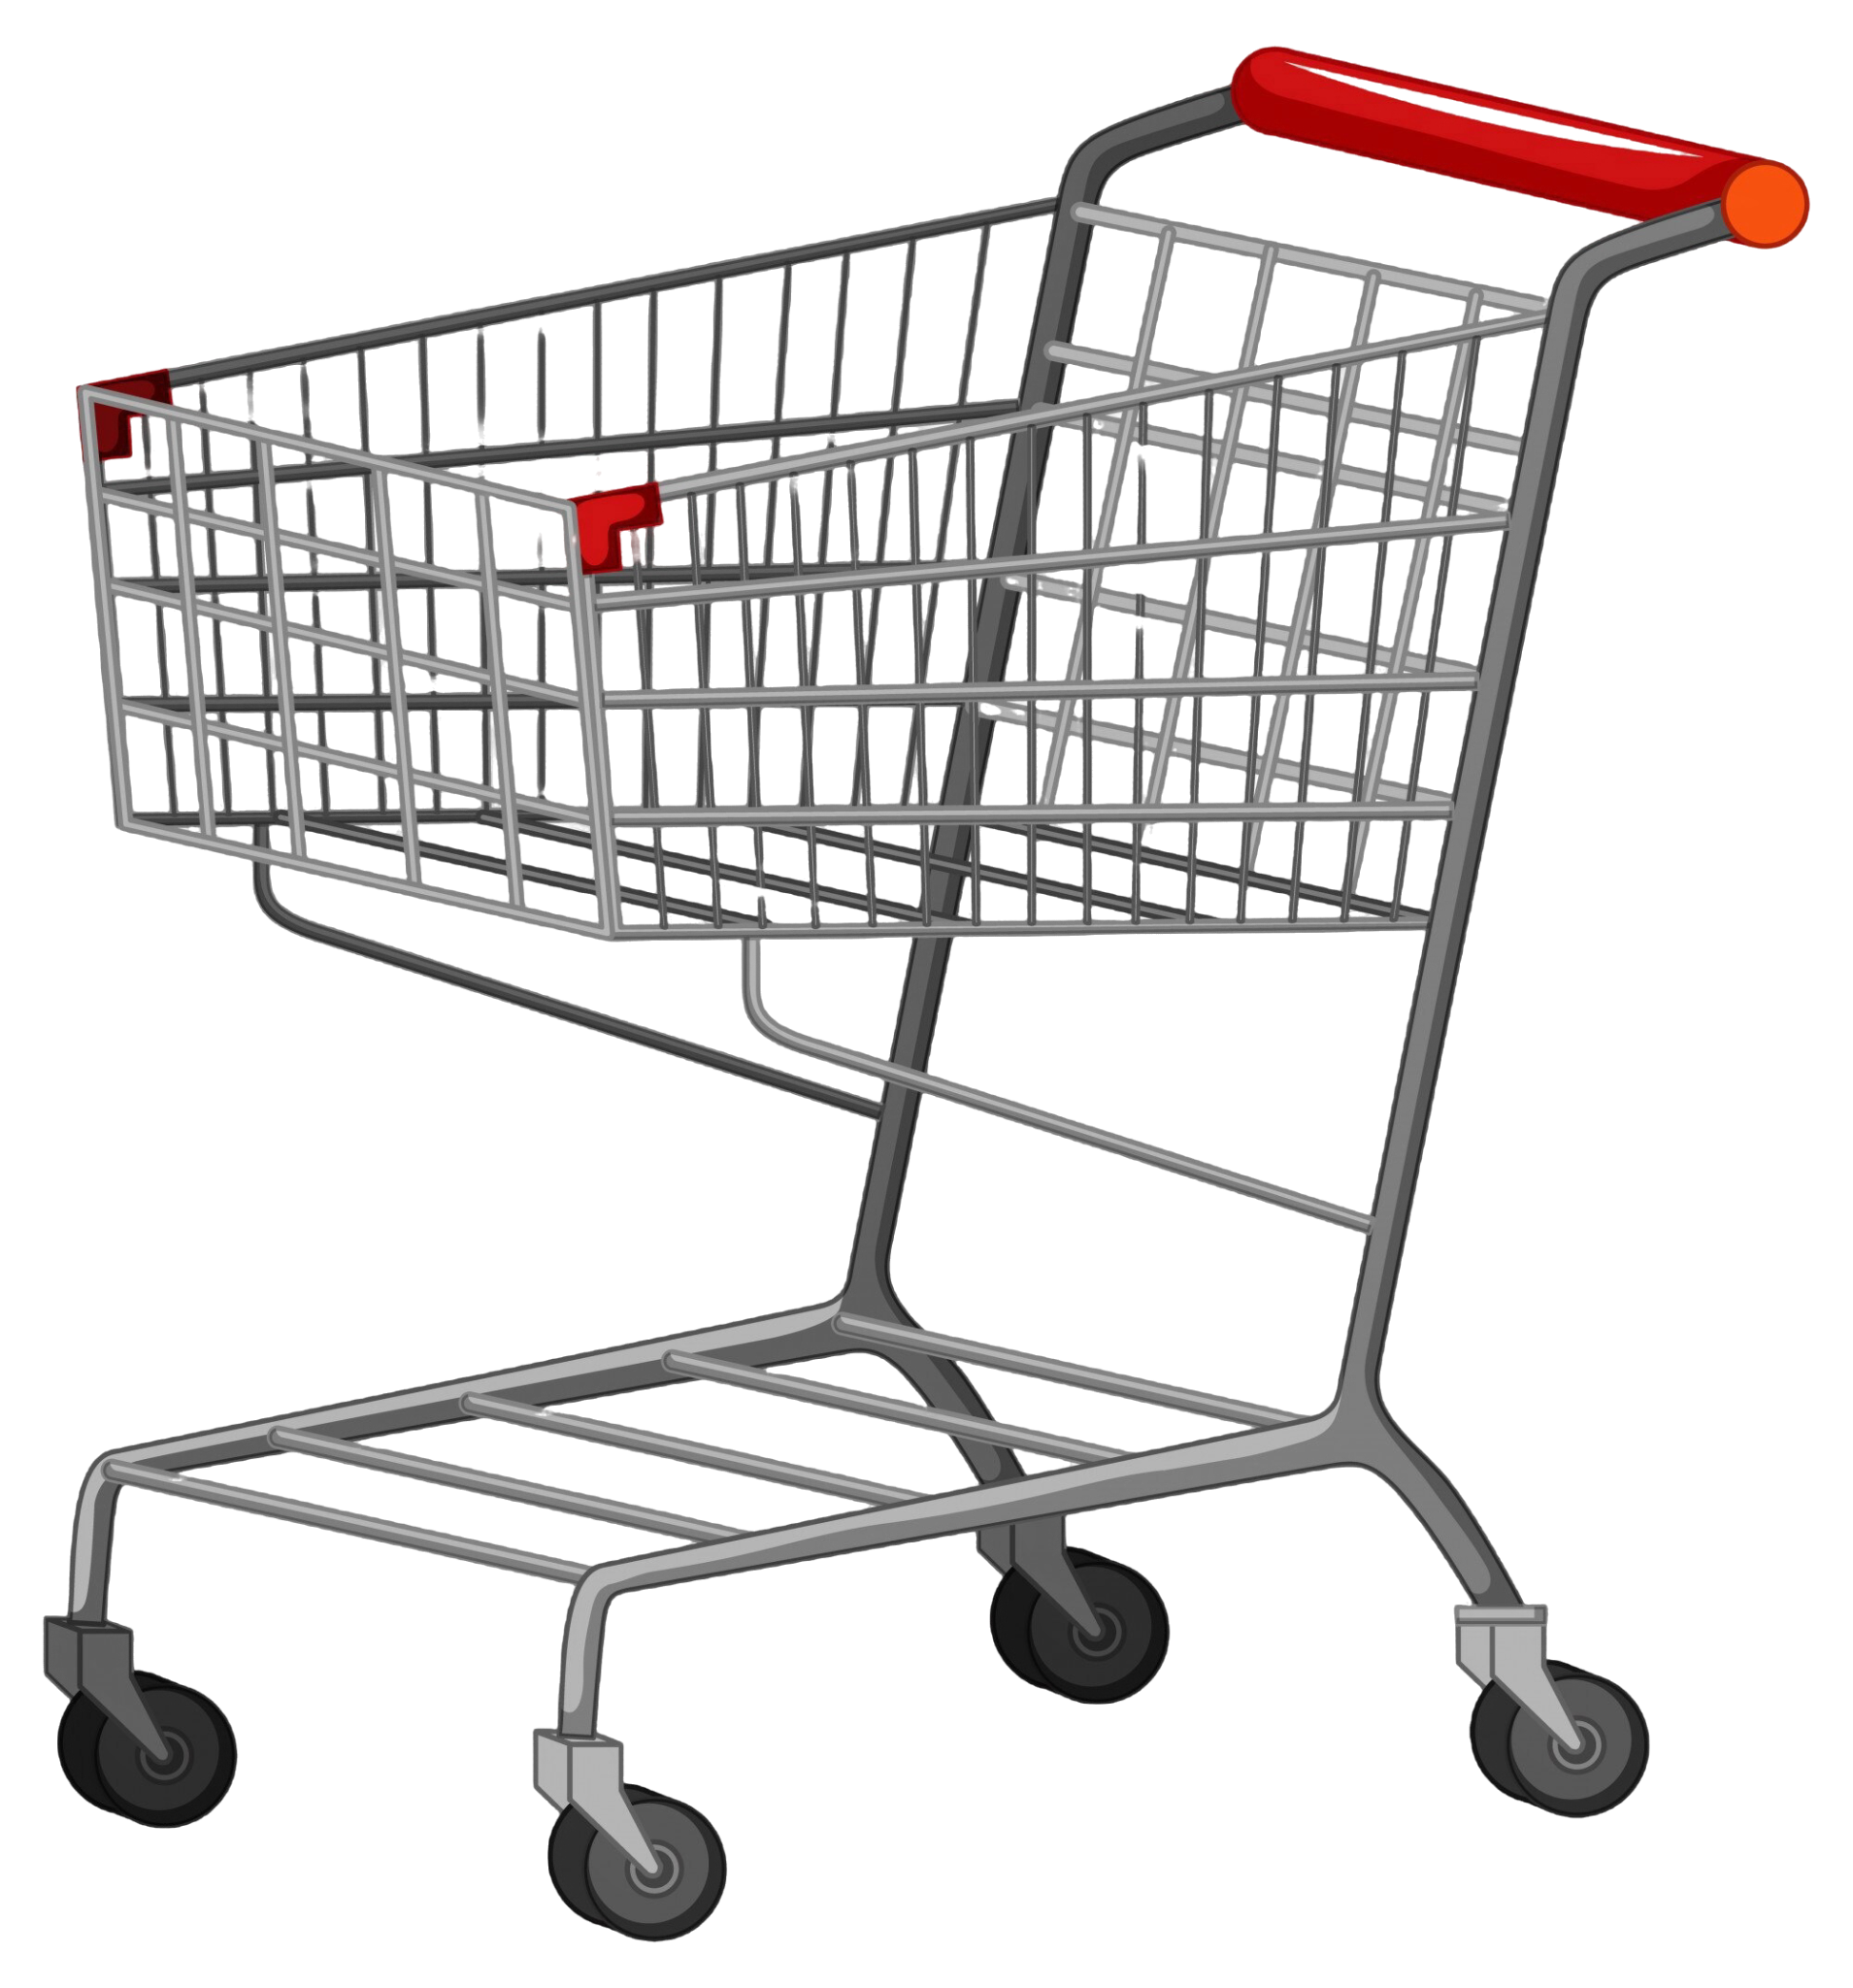
01
02
BACKGROUND
& FOCUS PROBLEM

Slide 3
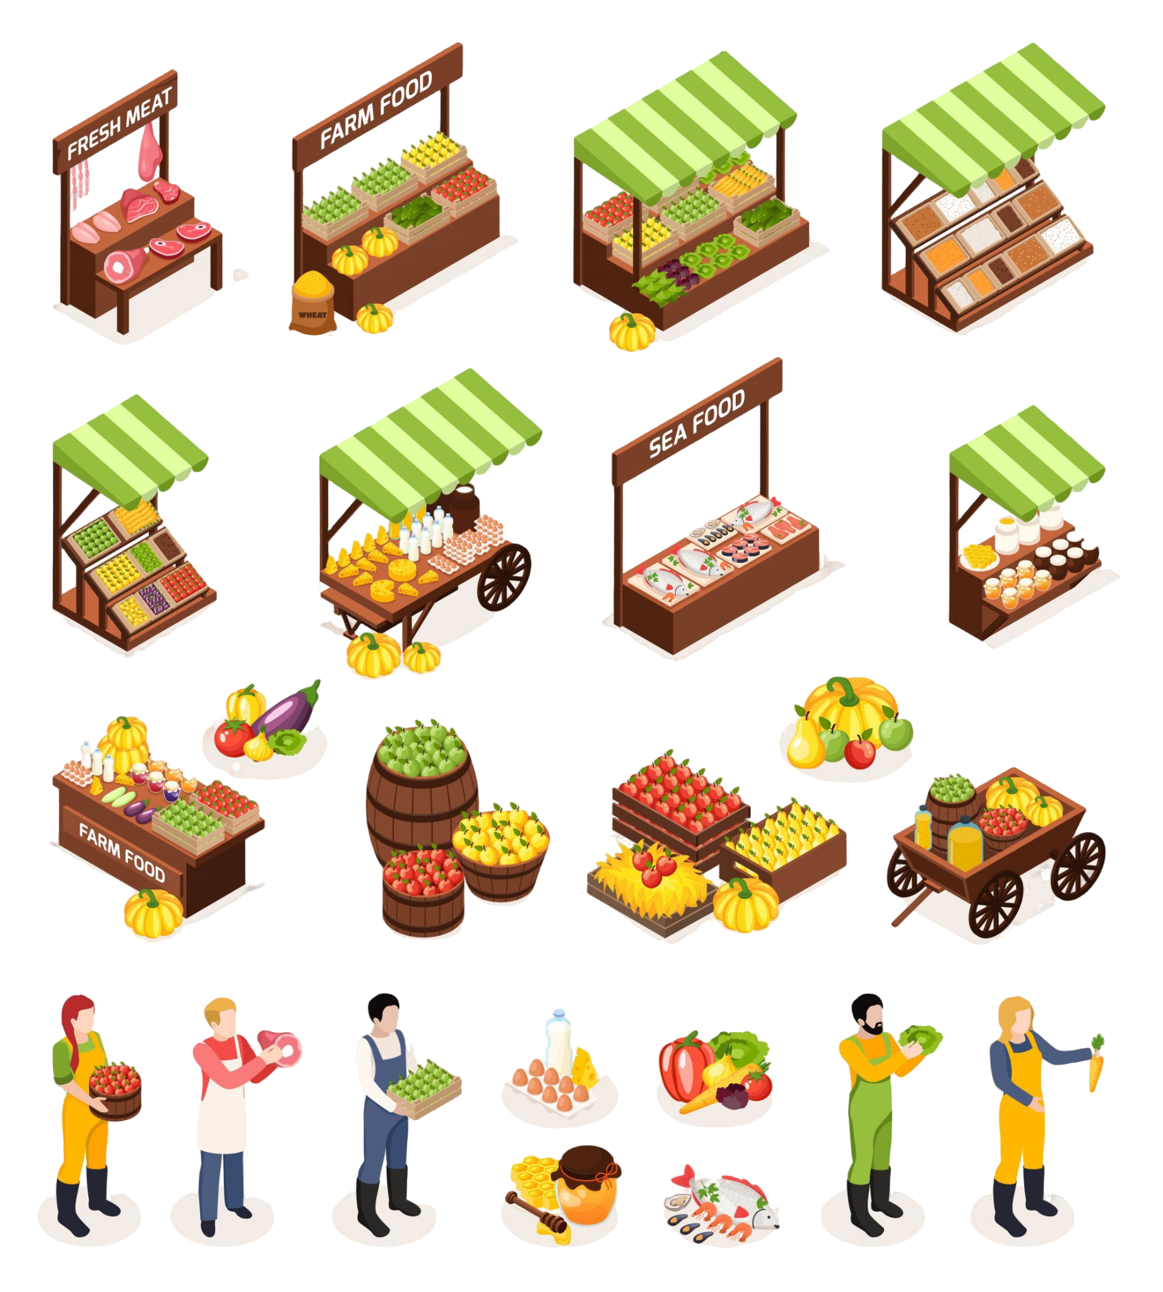
FOCUS BACKGROUND
The Good Grocer is one of the USA’s top grocery retail company focused on capturing a larger share of the healthy food market by making nutritious, high-quality products accessible at affordable prices.
Notes:
The Good Grocer is a grocery retail company focused on capturing a larger share of the healthy food market by making nutritious, high-quality products accessible at affordable prices. Facing a competitive landscape dominated by premium pricing, The Good Grocer aims to bridge the gap between health-conscious demand and affordability, driving growth by targeting diverse consumer segments with tailored pricing and strategic promotions. This approach not only strengthens customer loyalty and acquisition but also positions the company as a leader in democratizing healthy eating options across income levels.

Slide 4
FOCUS QUESTION
The core question they are asking our consulting team to solve is:
"How can we integrate affordability into our healthy food offerings to boost market share and promote healthier choices?
We need to understand how this strategy will impact incremental sales, customer behavior, and contribute to sustained business growth and profitability."

Slide 5
OUR PRELIMINARY
UNDERSTANDING + ANALYSIS
Goal: Expand market share in the healthy food sector by making nutritious products affordable.
Market Potential: U.S. healthy food market valued at $1 trillion and growing 5% annually.
Competitive Edge: Positioned to capture price-sensitive customers seeking affordable, nutritious options.
Target Impact: Drive 20-30% increase in healthy product sales by optimizing affordability.
Strategy: Tailored pricing, strategic promotions, and targeted customer segmentation to boost accessibility.
Outcome: Enhance customer loyalty, expand market reach, and position as an industry leader in accessible healthy eating.

Slide 6
MARKET LANDSCAPE
Customer Demand Analysis
78%
of customers report a preference for nutritious, organic, and sustainably sourced products.
65%
indicate price sensitivity as a key factor, limiting purchases of healthier options.
0.6
elasticity score for healthy products, indicating moderate sensitivity to price changes in this segment.
10%
year-over-year growth in demand for affordable healthy food options, especially among lower- and middle-income groups.
Notes:
Elasticity - score - specific For products with high price elasticity (e.g., elasticity > 1), even minor price reductions lead to significant demand increases.
For instance, a 10% price cut on a popular item could boost sales by 20%, supporting customer acquisition and retention.

Slide 7
MARKET LANDSCAPE
Competition Analysis
15%
Market Share in the health-food segment
17%
Competitors price health products is at a 17% premium
70%
Competitors dominate 70% of the urban market, leaving 35% of suburban/rural markets open for affordable options
12%
Health-food sector growth annually, outpacing the 9% growth in conventional grocery

Slide 8
CUSTOMER SEGMENTATION
Segment Name | Description | Key Variables | Purchasing Behavior
Health-Conscious Budget Shoppers | Budget-sensitive focused = healthier choices | Low-to-moderate income high sensitivity to discounts weekly shoppers | Choose affordable, healthier options; prefer store brands and discount aisles, especially during promotions
Premium Wellness Seekers | High-income prioritizing quality & health | High income, preference for organic, moderate frequency | Seek premium and organic items, willing to pay for specialty items (superfoods, supplements) regardless of discounts
Young Professionals on the Go | Busy professionals seeking convenient healthy options | Moderate-to-high income, frequent shoppers (2-3 times/week) | Opt for grab-and-go health options (salads, smoothies); value convenience and minimal prep time
Eco-Conscious Buyers | Environmentally-minded valuing sustainable products | Moderate-to-high income, preference for organic, moderate frequency | Purchase sustainably sourced, minimal-packaged; prioritize brands with environmental certifications
Family-Focused Savers | Mid-to-low-income families focused on nutritious value | Moderate income, low frequency (typically weekly), bulk purchasing | Seek cost-effective health basics (whole grains, dairy); buy larger sizes or multi packs to reduce cost per unit
Occasional Indulgers | Shoppers mixing health-conscious purchases with indulgent items | Low-to-moderate income, weekend-focused shopping | Purchase essential healthy items but often add indulgences (snacks, sweets) during weekend shopping trips
Notes:
Need to reverse engineer data for thiss
CUSTOMER AGE
CUSTOMER INCOME
PURCHASE HISTORY
Transaction ID: The ID of each individual transaction.
Product ID: The ID of the product purchased.
Quantity: The quantity of the product sold.
Sales Amount

Slide 9
FOCUS CHALLENGES
Affordability vs. Quality
Higher Costs | Healthy food products, especially those that are organic or sustainably sourced, can cost 20-30% more to produce compared to conventional items. This production cost drives up retail prices, making affordability a core challenge.
Price Accessibility Goal | The Good Grocer might have to aim to reduce the price premium of healthy items by 10-15% to make them accessible to a wider audience, especially targeting lower-income or price-sensitive customers.
Notes:
Affordability vs. Quality:
Higher Costs: Healthy food products, especially those that are organic or sustainably sourced, can cost 20-30% more to produce compared to conventional items. This production cost drives up retail prices, making affordability a core challenge.
Price Accessibility Goal: The Good Grocer aims to reduce the price premium of healthy items by 10-15% to make them accessible to a wider audience, especially targeting lower-income or price-sensitive customers.
Customer Segmentation:
Diverse Customer Needs: Among The Good Grocer’s customer base, approximately 40% are price-sensitive, seeking the most affordable options. However, 35% prioritize quality over cost, often opting for premium products.
Balancing Affordability and Demand: Reaching and retaining these price-sensitive groups, without alienating higher-spending customers, is critical for maximizing market share across segments.
Market Positioning:
Competitive Landscape: The healthy food market, valued at approximately $800 billion globally and growing at 7% CAGR, is increasingly competitive. Other retailers in this space often command a 20-50% price premium on health-focused products, appealing to high-income segments.
Differentiation Strategy: The Good Grocer seeks to differentiate by offering healthy, affordable options, aiming to capture a larger portion of this market while competing against both premium health-focused and conventional grocery stores.

Slide 10
FOCUS CHALLENGES
Customer Segmentation
Diverse Customer Needs | Among The Good Grocer’s customer base, approximately 40% are price-sensitive, seeking the most affordable options. However, 35% prioritize quality over cost, often opting for premium products.
Balancing Affordability and Demand | The Good Grocer might have to aim to reduce the price premium of healthy items by 10-15% to make them accessible to a wider audience, especially targeting lower-income or price-sensitive customers.
Notes:
Affordability vs. Quality:
Higher Costs: Healthy food products, especially those that are organic or sustainably sourced, can cost 20-30% more to produce compared to conventional items. This production cost drives up retail prices, making affordability a core challenge.
Price Accessibility Goal: The Good Grocer aims to reduce the price premium of healthy items by 10-15% to make them accessible to a wider audience, especially targeting lower-income or price-sensitive customers.
Customer Segmentation:
Diverse Customer Needs: Among The Good Grocer’s customer base, approximately 40% are price-sensitive, seeking the most affordable options. However, 35% prioritize quality over cost, often opting for premium products.
Balancing Affordability and Demand: Reaching and retaining these price-sensitive groups, without alienating higher-spending customers, is critical for maximizing market share across segments.
Market Positioning:
Competitive Landscape: The healthy food market, valued at approximately $800 billion globally and growing at 7% CAGR, is increasingly competitive. Other retailers in this space often command a 20-50% price premium on health-focused products, appealing to high-income segments.
Differentiation Strategy: The Good Grocer seeks to differentiate by offering healthy, affordable options, aiming to capture a larger portion of this market while competing against both premium health-focused and conventional grocery stores.

Slide 11
FOCUS CHALLENGES
Market Positioning
Competitive Landscape | The healthy food market, valued at approximately $800 billion globally and growing at 7% CAGR, is increasingly competitive. Other retailers in this space often command a 20-50% price premium on health-focused products, appealing to high-income segments.
Differentiation Strategy | The Good Grocer might have to seek to differentiate by offering healthy, affordable options, aiming to capture a larger portion of this market while competing against both premium health-focused and conventional grocery stores.
Notes:
Affordability vs. Quality:
Higher Costs: Healthy food products, especially those that are organic or sustainably sourced, can cost 20-30% more to produce compared to conventional items. This production cost drives up retail prices, making affordability a core challenge.
Price Accessibility Goal: The Good Grocer aims to reduce the price premium of healthy items by 10-15% to make them accessible to a wider audience, especially targeting lower-income or price-sensitive customers.
Customer Segmentation:
Diverse Customer Needs: Among The Good Grocer’s customer base, approximately 40% are price-sensitive, seeking the most affordable options. However, 35% prioritize quality over cost, often opting for premium products.
Balancing Affordability and Demand: Reaching and retaining these price-sensitive groups, without alienating higher-spending customers, is critical for maximizing market share across segments.
Market Positioning:
Competitive Landscape: The healthy food market, valued at approximately $800 billion globally and growing at 7% CAGR, is increasingly competitive. Other retailers in this space often command a 20-50% price premium on health-focused products, appealing to high-income segments.
Differentiation Strategy: The Good Grocer seeks to differentiate by offering healthy, affordable options, aiming to capture a larger portion of this market while competing against both premium health-focused and conventional grocery stores.

Slide 12
03
RESEARCH OBJECTIVES

Slide 13
CORE RESEARCH OBJECTIVE
How can using affordability as a key metric to promote healthy food products help a grocery retailer increase sales, attract and retain customers, and boost long-term profits, while staying competitive in pricing and growing in the health food market?

Slide 14
RESEARCH OBJECTIVES
Evaluate the Impact of Affordability on Sales Performance
1
Identify and Profile Price-Sensitive Customer Segments
2
Benchmark Competitor Pricing Strategies
3
4
Develop an Affordability Metric for Healthy Products
Notes:
Sales & Pricing: Track sales and revenue, analyzing pricing and discount impact.
Segmentation: Identify price-sensitive groups by demographics.
Competitor Pricing: Compare pricing strategies with competitors.
Satisfaction & Retention: Assess how affordability affects customer loyalty.
Promotion Impact: Measure the effect of affordable promotions on sales.
Acquisition & Lifetime Value: Analyze affordability’s role in attracting and keeping customers.
Affordability Metric: Create and assess its impact on sales and behavior.

Slide 15
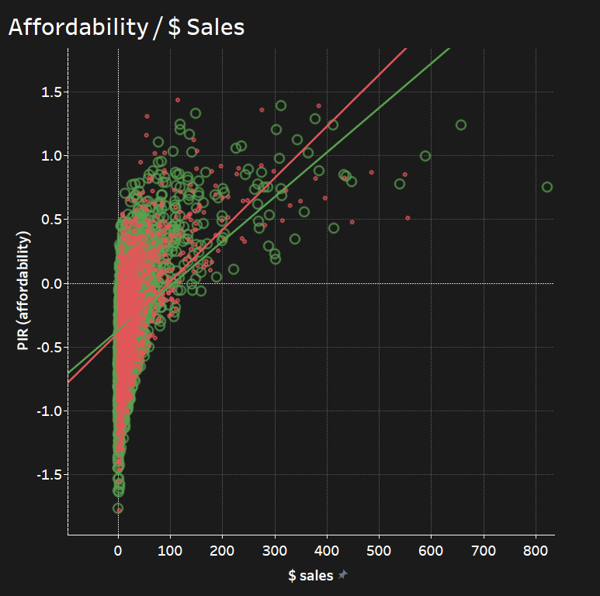

RESEARCH OBJECTIVE
Evaluate the Impact of Affordability on Sales Performance
1
The affordability is a key driver of sales performance for healthier items, as indicated by the steeper slope of the green trend line.
As affordability improves (lower PIR values), there is a more noticeable increase in sales for healthier items compared to not-healthier items.
Consumers are more willing to buy healthier items when these products are priced in alignment with average incomes.
Notes:
Regression Analysis: Identifies the relationship between variables like price, competitor price, and category, and how they affect sales volume and revenue
Context project Context of research objective Analysis Outcome

Slide 16
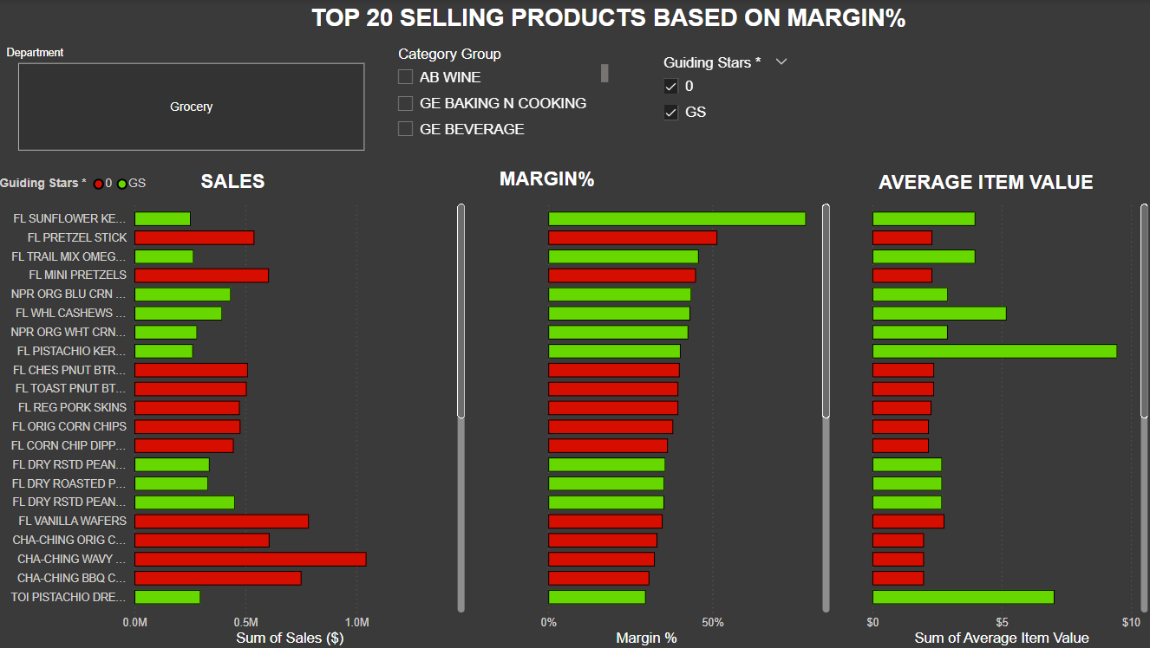
RESEARCH OBJECTIVE
Evaluate the Impact of Affordability on Sales Performance
1
Price Sensitivity for Non-Healthier Items:
The popularity of less healthy items with lower average item values suggests that affordability is a significant driver of sales for these products. Consumers are likely price-sensitive, favoring cheaper snack options despite the lack of health benefits.
Profitability of Healthier Items:
High-margin, healthier products like FL Sunflower Kernels show that consumers are willing to pay a premium for perceived health benefits. This indicates a demand for healthier options when they are positioned as high-value products.
*numbers masked for data privacy reasons
Notes:
Regression Analysis: Identifies the relationship between variables like price, competitor price, and category, and how they affect sales volume and revenue
Context project Context of research objective Analysis Outcome

Slide 17
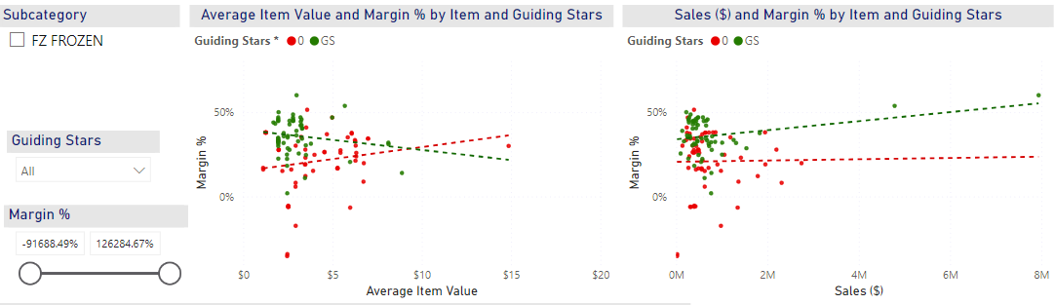
RESEARCH OBJECTIVE
Evaluate the Impact of Affordability on Healthy Sales Performance
1
Healthier Items with Higher Margins and Sales:
The positive slope of the green trend line in the right chart indicates that healthier items are capable of achieving both higher margins and higher sales, provided they are priced within an acceptable range.
This suggests that while healthier items may command a premium, consumers are willing to pay for the added value if affordability is reasonable.
Notes:
Regression Analysis: Identifies the relationship between variables like price, competitor price, and category, and how they affect sales volume and revenue
Context project Context of research objective Analysis Outcome

Slide 18
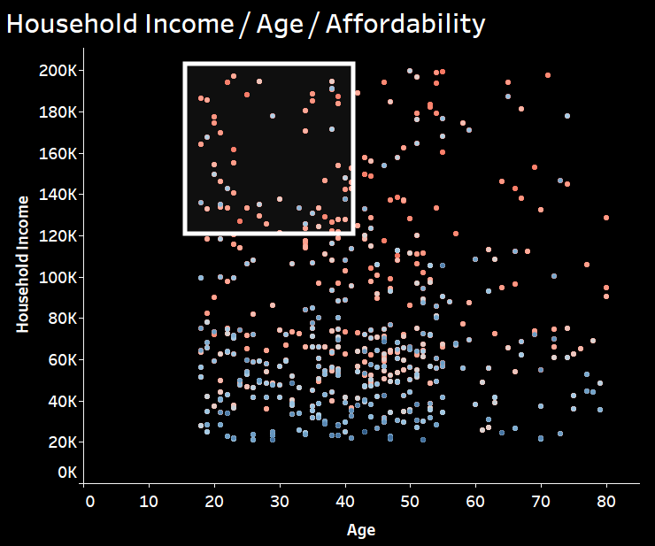
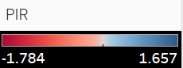
RESEARCH OBJECTIVE
Identify & Profile Price-Sensitive Customer Segments
2
This analysis highlights that younger, low-income consumers（the cluster near the bottom left） are highly price-sensitive and may prioritize affordability over health due to income constraints.
This group’s PIR values are generally high, shown by the red or orange points.
In contrast, middle- to high-income consumers are less affected by affordability, allowing them to select healthier options if they perceive them as valuable.
Notes:
Conduct a detailed segmentation analysis to identify price-sensitive groups based on demographics and purchasing behavior.
Utilize cluster analysis and
demographic segmentation techniques to characterize these segments and understand their unique preferences and buying patterns.
Customer segmentation Which attributes Price sensitive Health perspective Overall strategy

Slide 19
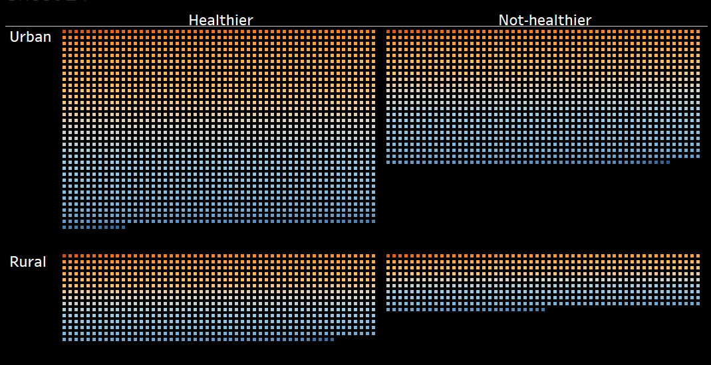
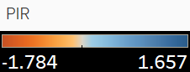
RESEARCH OBJECTIVE
Identify & Profile Price-Sensitive Customer Segments
2
Healthier foods generally show a higher concentration of blue in both urban and rural areas, suggesting they are generally less affordable compared to not-healthier items.
Not-healthier foods in rural areas tend to be more affordable overall than in urban areas, likely making them a more appealing choice for budget-conscious consumers in rural settings.
Notes:
Conduct a detailed segmentation analysis to identify price-sensitive groups based on demographics and purchasing behavior.
Utilize cluster analysis and
demographic segmentation techniques to characterize these segments and understand their unique preferences and buying patterns.
Customer segmentation Which attributes Price sensitive Health perspective Overall strategy

Slide 20
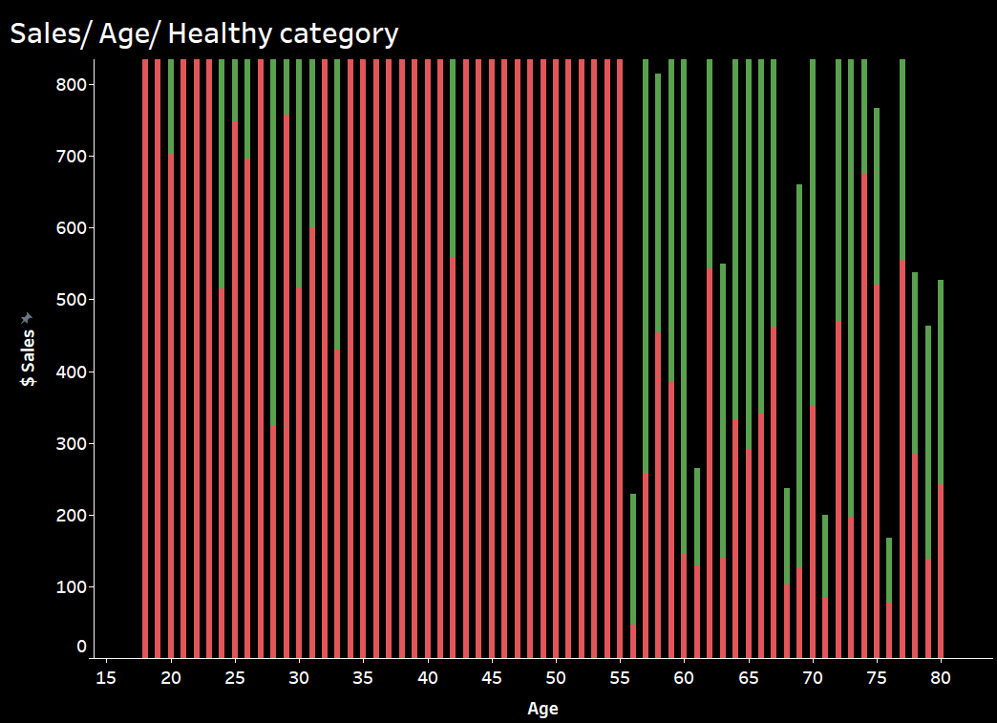

RESEARCH OBJECTIVE
2
Identify & Profile Price-Sensitive Customer Segments
The provided plot visualizes sales data for two product categories (Healthier and Not-Healthier) across different age groups.
A notable trend emerges: a decline in sales for Not-Healthier products in the middle-aged (35-55) demographic, indicating increased price sensitivity.
This segment, along with older adults (60+), appears to be more cost-conscious, suggesting a willingness to compromise on product attributes for affordability.
Notes:
Conduct a detailed segmentation analysis to identify price-sensitive groups based on demographics and purchasing behavior.
Utilize cluster analysis and
demographic segmentation techniques to characterize these segments and understand their unique preferences and buying patterns.
Customer segmentation Which attributes Price sensitive Health perspective Overall strategy

Slide 21

RESEARCH OBJECTIVE
Benchmark Competitor Pricing Strategies
3
Promotional Pricing:
Frequently offers promotions and discounts, particularly on fresh produce, dairy, and meats
These promotions are often highlighted through weekly specials and loyalty programs Loyalty Programs:
The MVP Customer Rewards program provides personalized deals and discounts, encouraging repeat business and fostering customer loyalty
Everyday Low Prices (EDLP):
Walmart has consistently employed an EDLP strategy, aiming to offer competitive prices across a broad product range
This approach leverages the company's significant purchasing power to maintain low prices
Competitive Promotions:
Walmart engages in promotional activities, especially during key shopping seasons

Slide 22
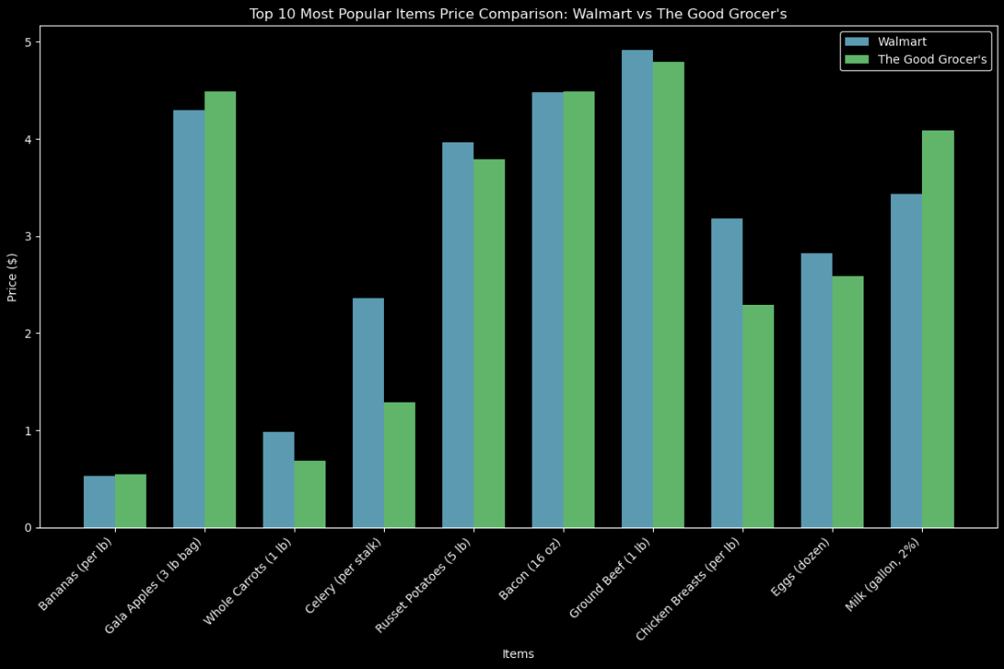
RESEARCH OBJECTIVE
Benchmark Competitor Pricing Strategies
3
The plot presents a price comparison of TOP 10 SELLING ITEMS between Walmart and The Good Grocer. It aims to benchmark competitive pricing strategies and identify areas for improvement.

Slide 23
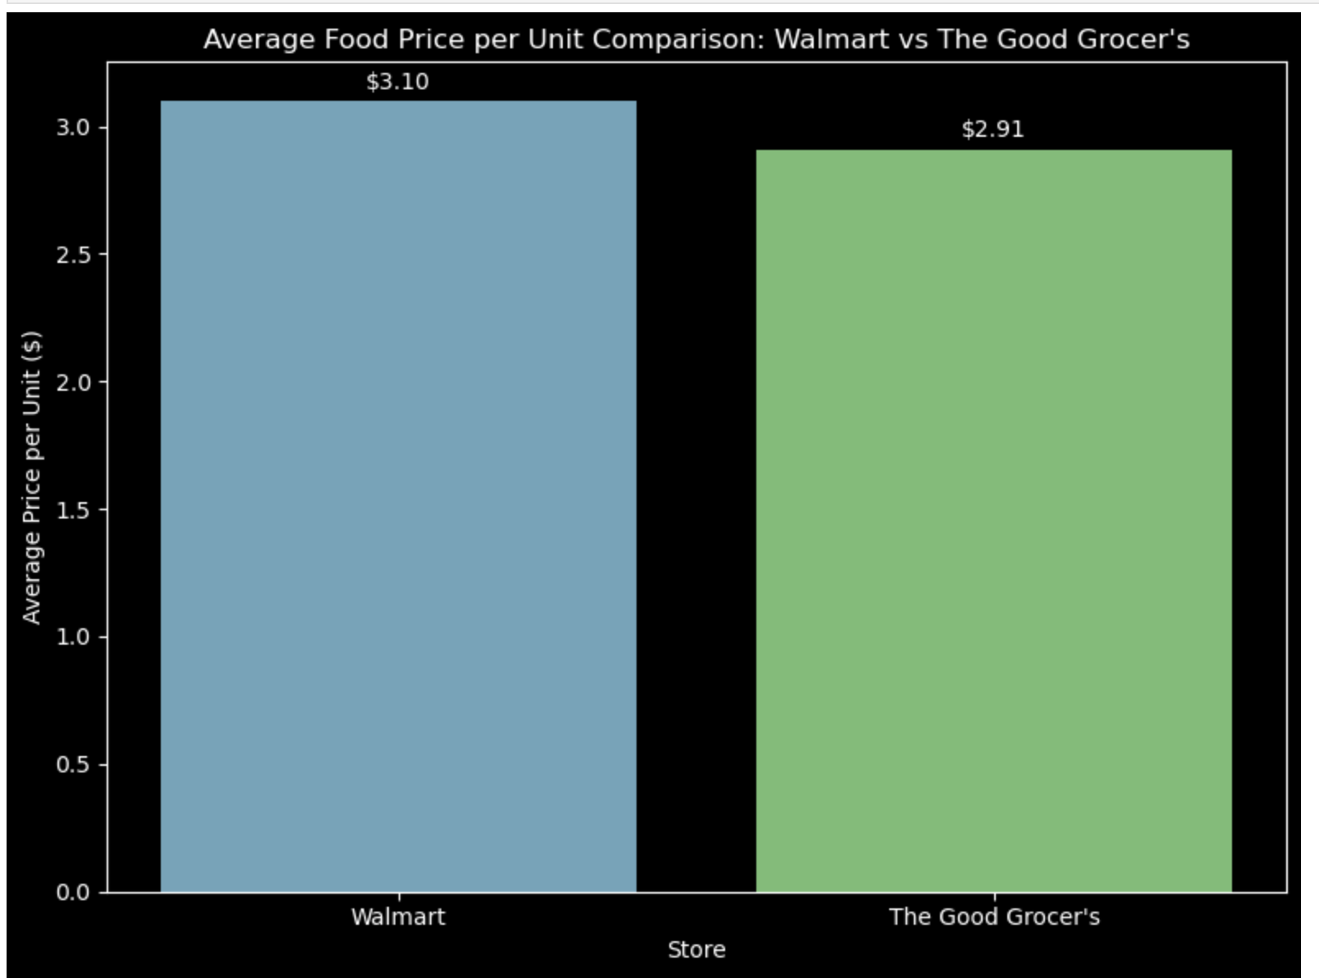
RESEARCH OBJECTIVE
Benchmark Competitor Pricing Strategies
3
If your main purpose is to purchase mainly groceries where should you go?

Slide 24
RESEARCH OBJECTIVE
Benchmark Competitor Pricing Strategies
3
Market Basket Analysis
Market basket analysis is a powerful data mining technique that helps you uncover the products your customers frequently buy together. By understanding these patterns, you can:
Create targeted promotions: Offer discounts on complementary products to increase average order value.
Optimize store layouts: Place related products together to encourage impulse purchases.
Identify emerging trends: Spot new product opportunities and adapt your inventory accordingly.

Slide 25
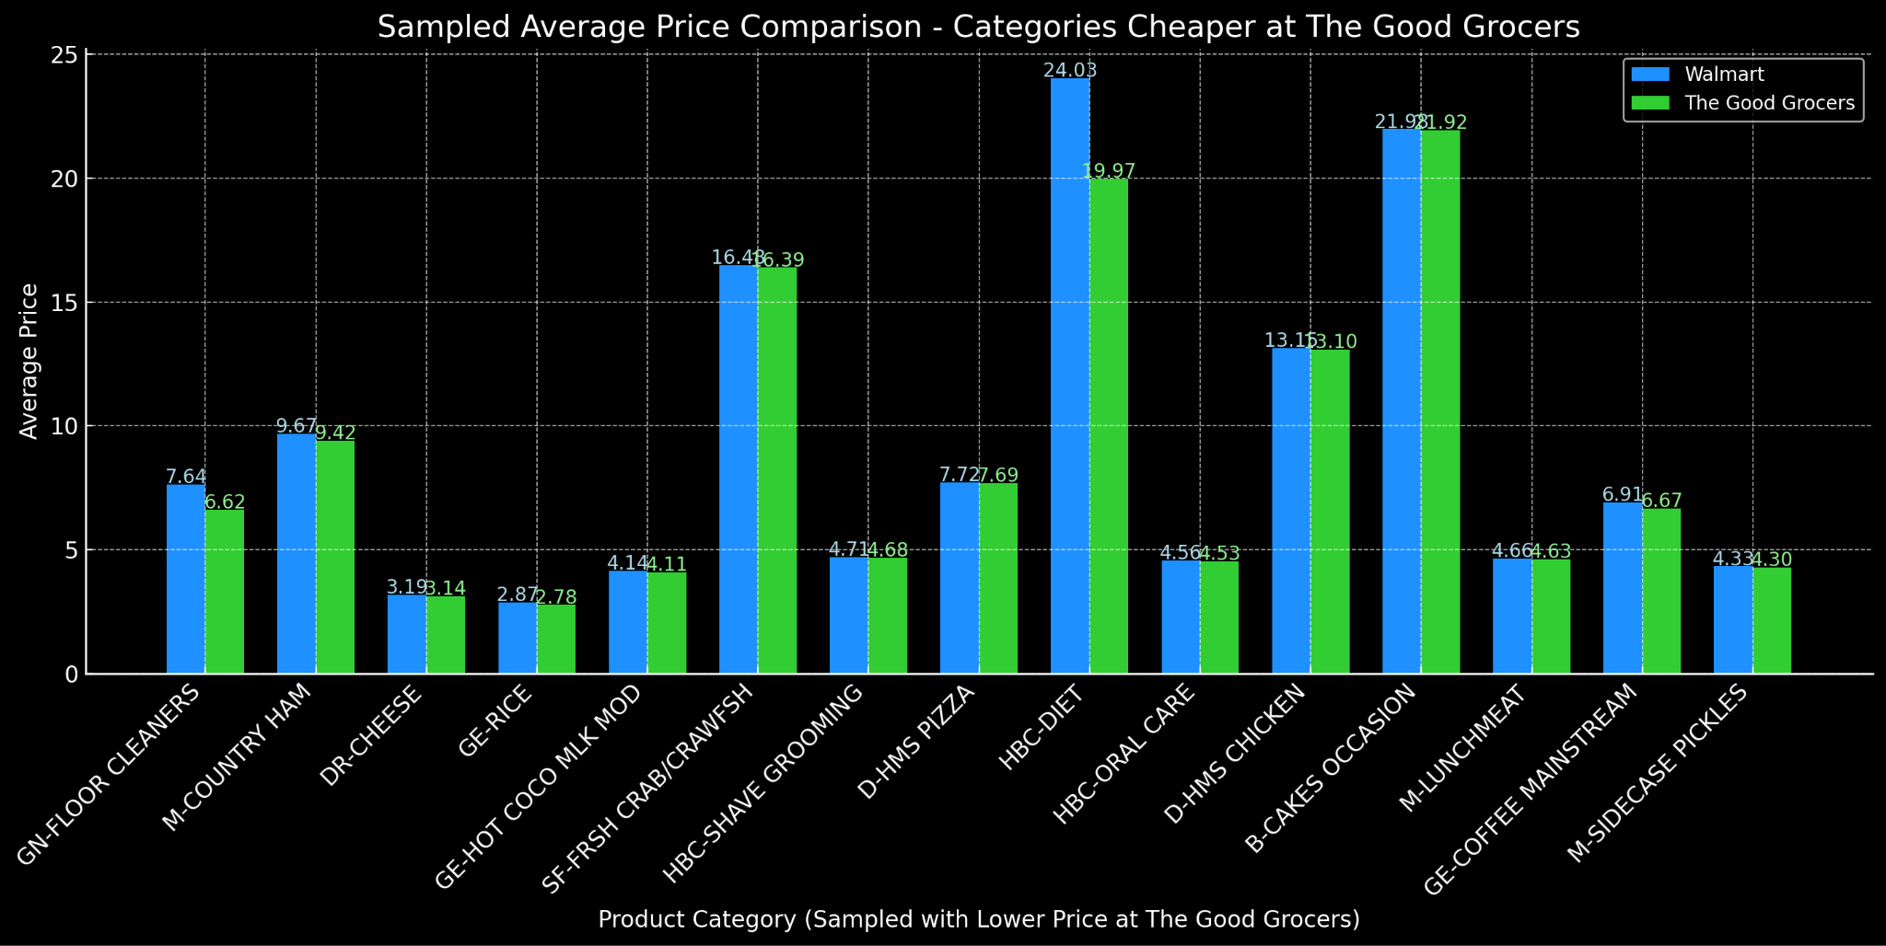
RESEARCH OBJECTIVE
Benchmark Competitor Pricing Strategies
3
Basket Analysis
Cost Comparison: Good Grocer’s vs Walmart
$129.96
$136.05

Slide 26
RESEARCH OBJECTIVE
Benchmark Competitor Pricing Strategies
3
Price Fluctuations
Consumer Perception
While Walmart's EDLP strategy aims for consistent pricing, it has made notable price adjustments in response to economic conditions, such as implementing thousands of price cuts amid inflation.
Walmart's broad price reductions and promotional activities during inflationary periods have positioned it as a value leader, attracting budget-conscious shoppers.
The Good Grocer’s pricing is more dynamic, with frequent promotions leading to price fluctuations.
The Good Grocer’s targeted promotions and loyalty rewards appeal to customers seeking deals on specific items, particularly fresh produce (healthy items) and meats.

Slide 27
RESEARCH OBJECTIVE
Develop an Affordability Metric for Healthy Products
4
Price-to-Income Ratio (PIR)
Basket Affordability Index
Promotional Sensitivity Index
Relative Price Comparison
Measures how well product prices align with average household incomes.
A lower PIR indicates that products are more affordable to a broader audience.
Evaluates affordability by comparing the cost of a typical basket of healthy products to the total household budget, offering insights into overall grocery affordability for customers.
Compares the price of healthy products to non-healthy alternatives, helping us understand if healthier choices are competitively priced.
Assesses the impact of discounts on sales volume, indicating how responsive different customer segments are to promotions.
LOG(Product Price / Average Household Income) * 10000)
% change in demand /
% change in price
Total basket cost / Average grocery budget
(Healthy Product Price / Non - Healthy Price) * 100
Notes:
Create and assess an affordability metric that captures the relationship between base prices, discounts, and final sales prices of healthy food products.
Use price elasticity modeling and
regression analysis to determine how changes in pricing influence consumer purchasing decisions and overall sales performance.

Slide 28
RESEARCH OBJECTIVE
Develop an Affordability Metric for Healthy Products
4
Price-to-Income Ratio (PIR)
Basket Affordability Index
Relative Price Comparison
Price Elasticity Demand
Products with lower PIR values are affordable to a broader range of customers, enhancing accessibility and potentially increasing sales volume.
For example, snacks priced with a PIR below 0.01% are well-positioned for average customers, indicating alignment with their spending capacity.
If a healthy basket costs under 20% of an average household grocery budget, it’s perceived as affordable. Our analysis shows that baskets priced within this threshold lead to higher conversion rates and promote the purchase of multiple healthy items, thus encouraging repeat purchases and customer loyalty.
For products with high price elasticity (e.g., elasticity > 1), even minor price reductions lead to significant demand increases.
For instance, a 10% price cut on a popular item could boost sales by 20%, supporting customer acquisition and retention.
If healthy alternatives are within 10-15% of the price of non-healthy items, customers are more likely to choose them.
Currently, items with a 10% premium over non-healthy options are still competitive but require strong value messaging to ensure market acceptance.
This suggests that strategic discounts on these items can drive higher sales volumes without drastically reducing profitability.
This allows the retailer to confidently position these products as affordable options.
Identifying items with excessive price premiums helps target pricing adjustments.
encouraging repeat purchases and customer loyalty
Notes:
Create and assess an affordability metric that captures the relationship between base prices, discounts, and final sales prices of healthy food products.
Use price elasticity modeling and
regression analysis to determine how changes in pricing influence consumer purchasing decisions and overall sales performance.

Slide 29
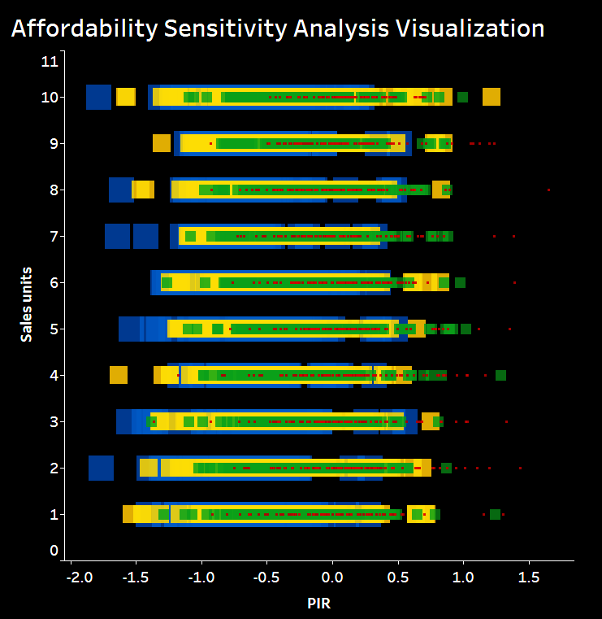
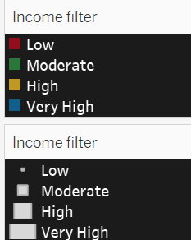
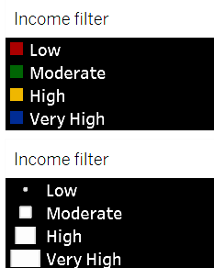
RESEARCH OBJECTIVE
Develop an Affordability Metric for Healthy Products
5
1. Middle-Income Sensitivity
Middle-income households (36-55) respond strongly to affordability on premium healthy items.
2. Low & Moderate Income Sensitivity to High PIR
Sales drop sharply for low/moderate-income groups as PIR rises.
3. Premium Product Elasticity for Middle-Income
Middle-income customers buy premium products when priced affordably.
4. High-Income Preference for Premium Quality
High-income customers show steady buying patterns regardless of PIR.
5. Income-Based Promotions
Each income group has unique affordability needs.
6. Incentivize Repeat Purchases
Middle-income customers are likely to return if prices remain favorable.
Notes:
Price-to-Income Ratio (PIR):
Formula: (Product Price / Average Household Income) * 100
Example: "If a product costs $5 and the average household income is $50,000, the PIR is (5 / 50000) * 100 = 0.01%. This helps us understand the affordability level of individual products."
Price Elasticity of Demand:
Formula: % change in demand / % change in price
Example: "If demand increases by 20% in response to a 10% price drop, price elasticity is 20 / 10 = 2. A high elasticity indicates sensitivity to pricing, aiding in pricing and promotion decisions."
Basket Affordability Index:
Formula: Total basket cost / Average grocery budget
Example: "If the cost of a healthy basket is $30 and the average grocery budget is $200, the index is (30 / 200) = 15%. This helps determine how accessible a healthy basket is for average customers."
Relative Price Comparison:
Formula: (Healthy Product Price / Non-Healthy Price) * 100
Example: "For a $3 healthy snack versus a $2.50 non-healthy option, the comparison ratio is (3 / 2.5) * 100 = 120%. Higher percentages indicate premium pricing for healthy items, impacting customer choices."

Slide 30

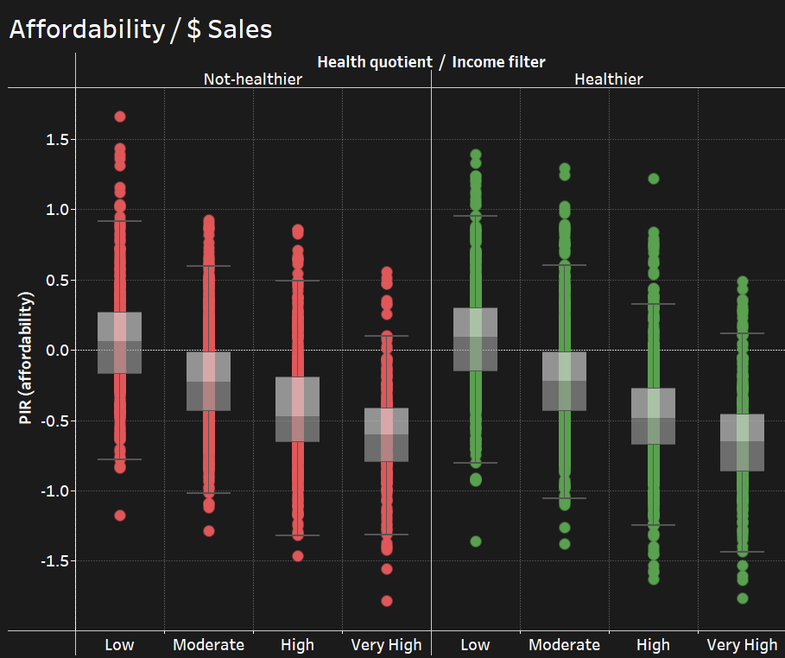
RESEARCH OBJECTIVE
Develop an Affordability Metric for Healthy Products
4
Healthier Products Are Highly Price-Sensitive
Lower-income groups are more responsive to affordability improvements for healthier options.
Action: Focus on making healthier options affordable for low and moderate-income segments.
Not-Healthier Products Show Stable Demand
Sales of "not-healthier" products are less affected by price changes.
Action: Maintain stable pricing for these items, as discounts may not drive significant sales increases.
Higher Income Groups Are Less Sensitive to Price Changes
Higher income customers show minimal demand changes with price shifts.
Action: Target higher-income groups with premium pricing based on product value rather than affordability.
Notes:
Price-to-Income Ratio (PIR):
Formula: (Product Price / Average Household Income) * 100
Example: "If a product costs $5 and the average household income is $50,000, the PIR is (5 / 50000) * 100 = 0.01%. This helps us understand the affordability level of individual products."
Price Elasticity of Demand:
Formula: % change in demand / % change in price
Example: "If demand increases by 20% in response to a 10% price drop, price elasticity is 20 / 10 = 2. A high elasticity indicates sensitivity to pricing, aiding in pricing and promotion decisions."
Basket Affordability Index:
Formula: Total basket cost / Average grocery budget
Example: "If the cost of a healthy basket is $30 and the average grocery budget is $200, the index is (30 / 200) = 15%. This helps determine how accessible a healthy basket is for average customers."
Relative Price Comparison:
Formula: (Healthy Product Price / Non-Healthy Price) * 100
Example: "For a $3 healthy snack versus a $2.50 non-healthy option, the comparison ratio is (3 / 2.5) * 100 = 120%. Higher percentages indicate premium pricing for healthy items, impacting customer choices."

Slide 31
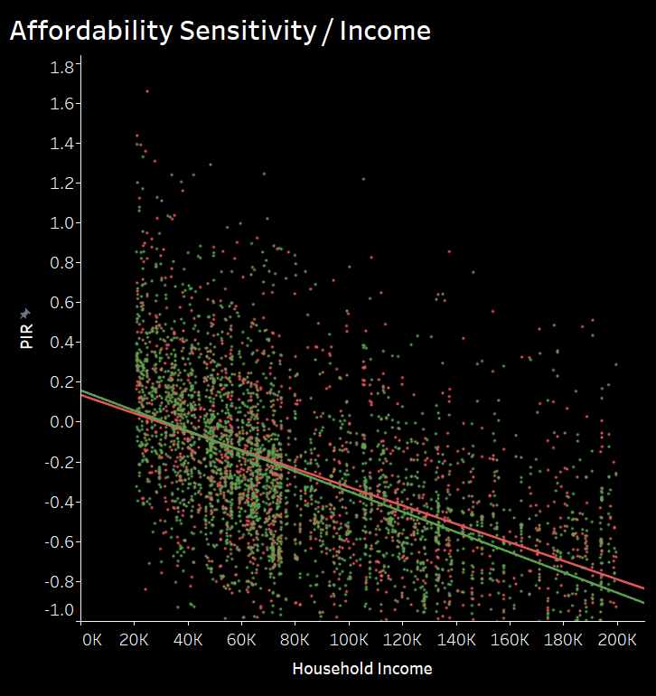
RESEARCH OBJECTIVE
Develop an Affordability Metric for Healthy Products
4
Affordability Gap: Lower-income households face greater affordability barriers, especially for healthier products.
Steeper Affordability Slope: Healthier products show a sharper affordability improvement with income (slope: -5.075e-06) than not-healthier products (slope: -4.625e-06).
Targeted Impact: Adjusting affordability for healthier items could make a significant difference for price-sensitive, low-income segments.
Statistical Confidence: Both affordability trends are statistically significant (p < 0.0001), with income being a meaningful factor in affordability perception.
Strategic Focus: Prioritize affordability initiatives for healthier options to increase accessibility and promote healthier choices among low-income consumers.
Notes:
Price-to-Income Ratio (PIR):
Formula: (Product Price / Average Household Income) * 100
Example: "If a product costs $5 and the average household income is $50,000, the PIR is (5 / 50000) * 100 = 0.01%. This helps us understand the affordability level of individual products."
Price Elasticity of Demand:
Formula: % change in demand / % change in price
Example: "If demand increases by 20% in response to a 10% price drop, price elasticity is 20 / 10 = 2. A high elasticity indicates sensitivity to pricing, aiding in pricing and promotion decisions."
Basket Affordability Index:
Formula: Total basket cost / Average grocery budget
Example: "If the cost of a healthy basket is $30 and the average grocery budget is $200, the index is (30 / 200) = 15%. This helps determine how accessible a healthy basket is for average customers."
Relative Price Comparison:
Formula: (Healthy Product Price / Non-Healthy Price) * 100
Example: "For a $3 healthy snack versus a $2.50 non-healthy option, the comparison ratio is (3 / 2.5) * 100 = 120%. Higher percentages indicate premium pricing for healthy items, impacting customer choices."

Slide 32
04
GROWTH STRATEGY
Notes:
1. Executive Summary of Strategy
Briefly summarize the goal: Establishing "The Good Grocer" as a leader in accessible healthy food by balancing affordability, customer retention, and market competitiveness.
2. Market Position & Opportunity
Define the market positioning and identify the opportunity within the healthy food sector.
Include relevant insights from segmentation analysis, showing that customer demand aligns with affordability and health.
3. Key Strategic Pillars
Affordability & Pricing Strategy
Use findings from affordability metrics, price elasticity, and competitor pricing to outline strategies for competitive, accessible pricing.
Customer-Centric Segmentation & Engagement
Leverage segmentation analysis to outline how pricing and promotions will target specific customer groups (e.g., “Health-Conscious Savers”).
Promotion & Retention Strategies
Develop promotion strategies backed by data from customer retention and satisfaction metrics, aiming to boost loyalty.
4. Analytical Roadmap for Execution
Outline the research methods that will support each strategy:
Sales and Pricing Analysis: Detail pricing strategies and anticipated sales impacts.
Customer Segmentation Analytics: Demonstrate how targeting segments improves reach and acquisition.
Retention Analysis: Predict how affordability affects customer loyalty over time.
5. Financial Projections & ROI
Based on financial projections, estimate the expected revenue growth, market share expansion, and profitability from the affordability-focused strategy.
6. Risk Assessment and Mitigation
Identify potential risks (e.g., margin impact) and propose mitigation strategies such as optimizing supply chains or cost reduction initiatives.
7. Implementation Timeline
Provide a phased timeline, aligning each strategic pillar with actionable steps, milestones, and evaluation points.
8. Expected Outcomes and KPIs
Define specific KPIs to measure success, including incremental sales growth, customer satisfaction scores, and market share.

Slide 33
Health Strategy for
Focus on Affordability for Key Income Segments
Strategic Promotions for Incremental Sales
Refine Product Mix to Align with Affordability Sensitivity
Data Insight: Healthier products show higher affordability sensitivity across low- to moderate-income households
Action: Adjust prices to target a PIR of -0.3 for low-income and -0.1 for moderate-income groups, aiming to boost sales conversion by 15-20%
Data Insight: Promotions on healthier products in the moderate-income bracket increase basket size and sales
Action: Offer targeted discounts on popular healthy items for middle-income customers to increase sales by 12-15% per campaign
Data Insight: Healthier options with PIR below -0.3 see 20% higher volume growth in lower-income segments
Action: Prioritize stocking of high-demand, low-PIR healthy products to capture an estimated 10% uplift in sales within low-income households
Expand Customer Base with Affordability as a Differentiator
Utilize Predictive Pricing for Competitive Positioning
Objective: Attract 5% new customers in lower-income segments within 6 months by positioning The Good Grocer as the go-to for affordable, healthy food
Objective: Attract 5% new customers in lower-income segments within 6 months by positioning The Good Grocer as the go-to for affordable, healthy food

Slide 34
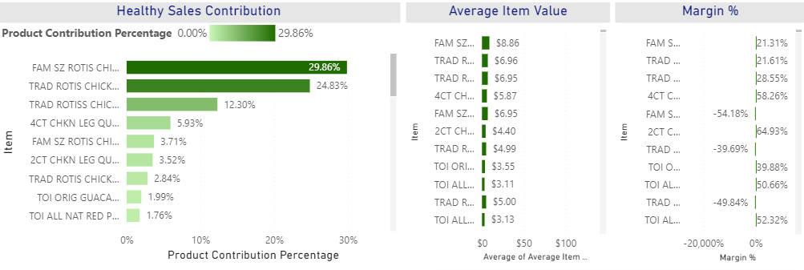
Leverage High Contribution, Low-Margin Items as Traffic Drivers
Use high-contribution, low-margin items like rotisserie chicken to attract price-sensitive customers who prioritize affordability.
Promote these items as “value deals” through in-store signage, digital ads, and weekly circulars.
Cross-sell high-margin healthier sides, such as pre-packaged salads, to increase basket value when customers purchase these loss leaders.
Notes:
Rotisserie chicken items (e.g., FAM SZ ROTIS CHICKEN and TRAD ROTIS CHICKEN) show high sales contribution but low or negative margins. These items can serve as loss leaders to attract more customers to the store, particularly price-sensitive shoppers looking for affordable, ready-to-eat healthy options

Slide 35
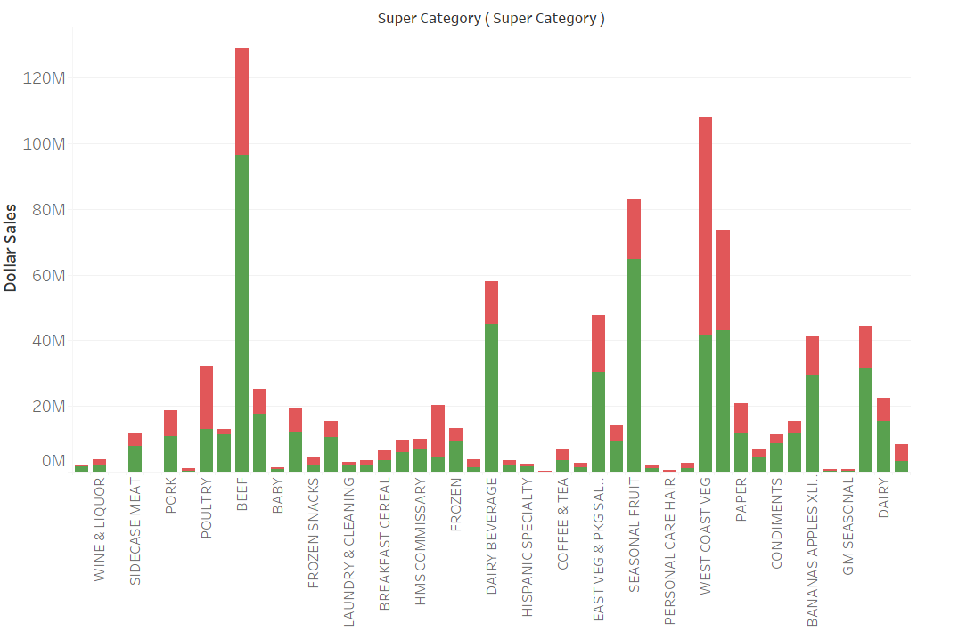
Develop Bundles Combining Healthier & Not-Healthier Options
Create bundled promotions that mix healthier and not-healthier items to encourage customers to try new healthier options without exceeding their budget.
Pair high-margin, healthier items (like guacamole or salads) with popular, affordable snacks (like chips) to appeal to price-sensitive shoppers.
Offer meal kits that combine ready-to-eat options, such as rotisserie chicken with fresh or pre-packaged vegetables, making it convenient and affordable to eat healthily.

Slide 36
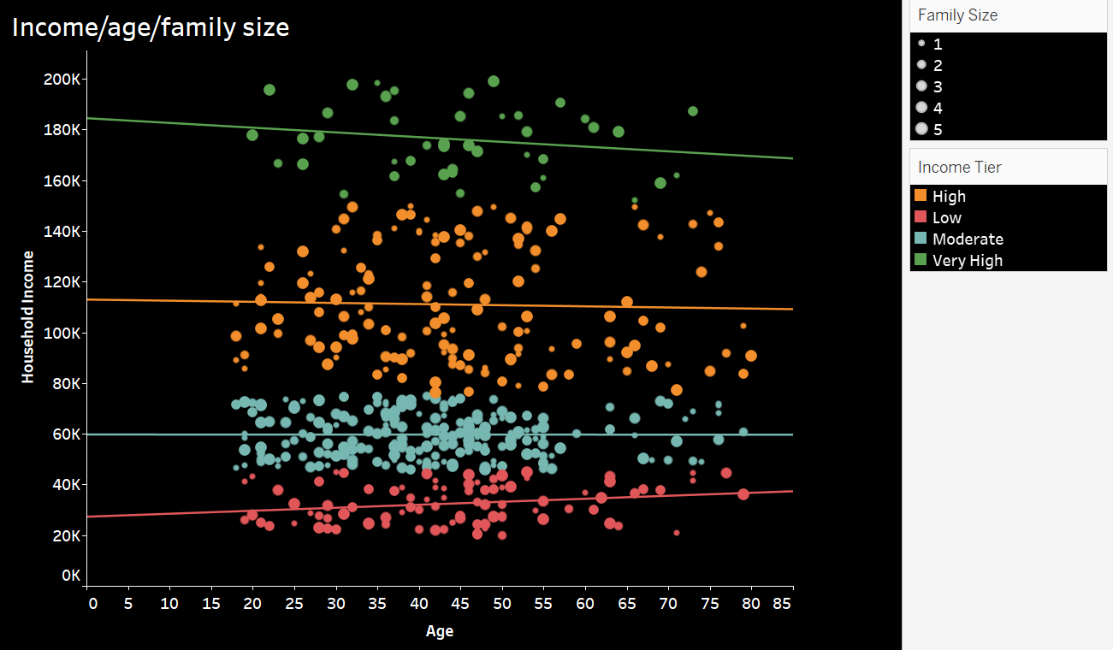
Segmented Pricing Strategies for Different Income Groups
Cater to different price sensitivities across demographic segments (younger, lower-income vs. higher-income, health-conscious customers).
For lower-income customers, offer discounts and promotions on high-demand, healthier essentials like grains, fruits, and vegetables.
For higher-income customers, introduce premium healthier options, such as organic or specialty products, focusing on quality and exclusivity rather than price.

Slide 37
Appendix
The price sensitivity decreases with income.
Low-income households, particularly young or elderly with larger family sizes, are highly price-sensitive and need affordable healthy options.
Moderate-income households are moderately price-sensitive and open to competitive pricing on healthy foods.
High-income and very high-income households are less sensitive to price and may prefer premium, health-oriented options.

Slide 38
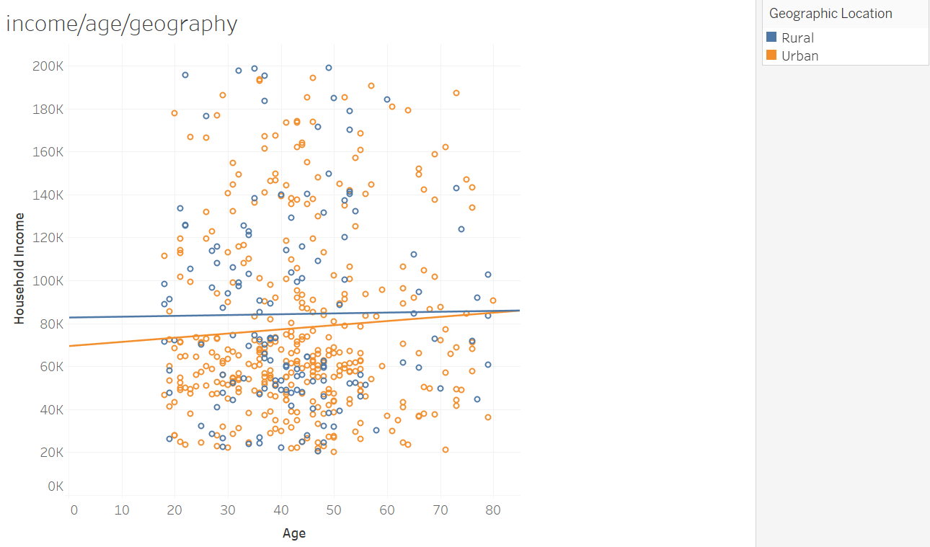
Appendix
The urban areas have greater income variability, with younger and low-income urban consumers being highly price-sensitive.
In rural areas, incomes are slightly higher on average, but there is still a large segment of price-sensitive consumers, particularly among younger and older adults.

Slide 39
Appendix
The certain categories are dominated by not-healthier items, while others show strong sales of healthier options.
Beef, Fruit, East Veg & Pkg Salad, and Dairy categories have a strong presence of healthier items (green bars) in their sales distribution.
By targeting price-sensitive segments with tailored promotions, bundle offers, and educational initiatives, The Good Grocer can encourage healthier purchases without deterring budget-conscious consumers.

Slide 40
Appendix
High Contribution, Low Margin: Items like FAM SZ ROTIS CHICKEN and TRAD ROTIS CHICKEN have high sales contributions but low or negative margins. These items could be used as loss leaders to draw in customers
High Margin, Lower Contribution: Items like 4CT CHKN LEG QUARTERS and TOI ORIG GUACAMOLE have high margins but contribute less to overall sales. Promoting these items could improve profitability.

Slide 41
Thank you!
“A healthy lifestyle is the foundation for a happy and fulfilling life”

